Slide 1
ECE408 / CS483
Applied Parallel Programming
Lecture 23:
Application Case Study – Electrostatic Potential Calculation

Slide 2
Objective
To learn how to apply parallel programming techniques to an application
  Thread coarsening for more work efficiency
  Data structure padding for reduced divergence
  Memory access locality and pre-computation techniques

Slide 3
VMD
Visual Molecular Dynamics
  Visualizing, animating, and analyzing bio-molecular systems
  More than 200,000 users as of 2012
  Batch (movie making) vs. interactive mode
  Run on laptops, desktops, clusters, supercomputers

Slide 4
Electrostatic Potential Map
Calculate initial electrostatic potential map around the simulated structure considering the contributions of all atoms
  Most time consuming, focus of our example.
r_{i,j}: distance from lattice point j to atom[i]
potential[j]: potential at lattice point being evaluated
atom[i]

Slide 5
Electrostatic Potential Calculation
The contribution of atom[i] to the electrostatic potential at lattice[j] is
potential[j] = atom[i].charge / r_{ij.}
In the Direct Coulomb Summation method, the total potential at lattice point j is the sum of contributions from all atoms in the system.

Slide 6
Overview of Direct Coulomb Summation (DCS) Algorithm
One way to compute the electrostatic potentials on a grid, ideally suited for the GPU
  All atoms affect all map lattice points, most accurate
For each lattice point, sum potential contributions for all atoms in the simulated structure:
  potential += charge[i] / (distance to atom[i])
Approximation-based methods such as cut-off summation can achieve much higher performance at the cost of some numerical accuracy and flexibility

Slide 7
Direct Coulomb Summation (DCS) Algorithm Detail
At each lattice point, sum potential contributions for all atoms in the simulated structure:
  potential[j] += charge[i] / (distance to atom[i])
r_{i,j}: distance from lattice point j to atom[i]
potential[j]: potential at lattice point being evaluated
atom[i]

Slide 8
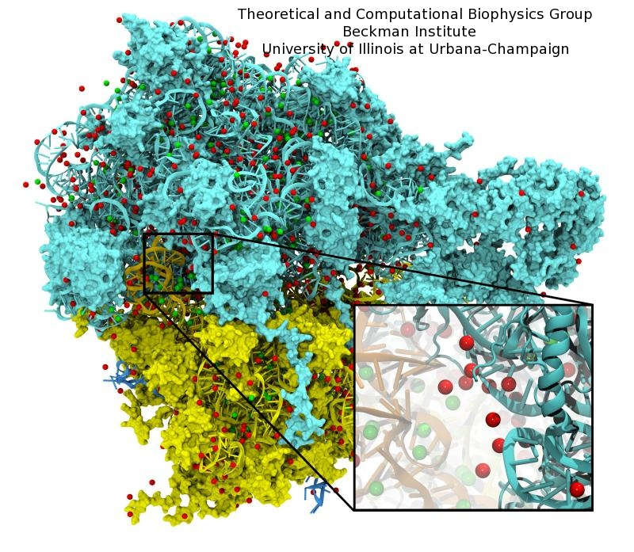
Irregular Input vs. Regular Output
Atoms come from modeled molecular structures, solvent (water) and ions
  Irregular by necessity
Energy grid models the electrostatic potential value at regularly spaced points
  Regular by design

Slide 9
Summary of Sequential C Version
Algorithm is input oriented
  For each input atom, calculate its contribution to all grid points in an x-y slice
Output (energygrid) is regular
  Simple linear mapping between grid point indices and modeled physical coordinates
Input (atom) is irregular
  Modeled x,y,z coordinate of each atom needs to be stored in the atom array
The algorithm is efficient in performing minimal calculations on distances, coordinates, etc.

Slide 10
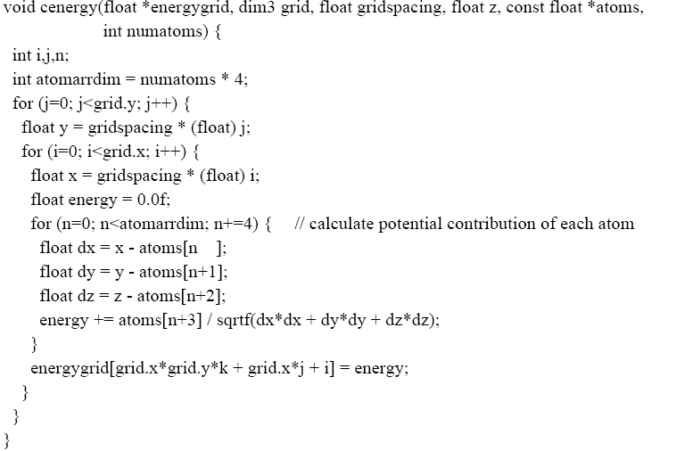
An Intuitive Sequential C Version
int k = z / gridspacing;
The grid parameter gives the number of grid points in each dimension of the lattice.

Slide 11
A More Optimized Sequential C Version
void cenergy(float *energygrid, dim3 grid, float gridspacing, float z, const float *atoms, int numatoms) {
int atomarrdim = numatoms * 4; //x,y,z, and charge info for each atom
int grid_slice_offset = (grid.x*grid.y*z) / gridspacing;
for (int n=0; n<atomarrdim; n+=4) { // calculate potential contribution of each atom
float dz = z - atoms[n+2]; // all grid points in a slice have the same z value
float dz2 = dz*dz;
float charge = atoms[n+3];
for (int j=0; j<grid.y; j++) {
float y = gridspacing * (float) j;
float dy = y - atoms[n+1]; // all grid points in a row have the same y value
float dy2 = dy*dy;
int grid_row_offset = grid_slice_offset+ grid.x*j;
for (int i=0; i<grid.x; i++) {
float x = gridspacing * (float) i;
float dx = x - atoms[n ];
energygrid[grid_row_offset + i] += charge / sqrtf(dx*dx + dy2+ dz2);
}
}
} }
Input oriented

Slide 12
An More Optimized Sequential C Version
void cenergy(float *energygrid, dim3 grid, float gridspacing, float z, const float *atoms, int numatoms) {
int grid_slice_offset = (grid.x*grid.y*z) / gridspacing;
int atomarrdim = numatoms * 4; //x,y,z, and charge info for each atom
for (int n=0; n<atomarrdim; n+=4) { // calculate potential contribution of each atom
float dz = z - atoms[n+2]; // all grid points in a slice have the same z value
float dz2 = dz*dz;
float charge = atoms[n+3];
for (int j=0; j<grid.y; j++) {
float y = gridspacing * (float) j;
float dy = y - atoms[n+1]; // all grid points in a row have the same y value
float dy2 = dy*dy;
int grid_row_offset = grid_slice_offset+ grid.x*j;
for (int i=0; i<grid.x; i++) {
float x = gridspacing * (float) i;
float dx = x - atoms[n ];
energygrid[grid_row_offset + i] += charge / sqrtf(dx*dx + dy2+ dz2);
}
}
} }

Slide 13
A More Optimized Sequential C Version
void cenergy(float *energygrid, dim3 grid, float gridspacing, float z, const float *atoms, int numatoms) {
int grid_slice_offset = (grid.x*grid.y*z) / gridspacing;
int atomarrdim = numatoms * 4; //x,y,z, and charge info for each atom
for (int n=0; n<atomarrdim; n+=4) { // calculate potential contribution of each atom
float dz = z - atoms[n+2]; // all grid points in a slice have the same z value
float dz2 = dz*dz;
float charge = atoms[n+3];
for (int j=0; j<grid.y; j++) {
float y = gridspacing * (float) j;
float dy = y - atoms[n+1]; // all grid points in a row have the same y value
float dy2 = dy*dy;
int grid_row_offset = grid_slice_offset+ grid.x*j;
for (int i=0; i<grid.x; i++) {
float x = gridspacing * (float) i;
float dx = x - atoms[n ];
energygrid[grid_row_offset + i] += charge / sqrtf(dx*dx + dy2+ dz2);
}
}
} }

Slide 14
An Intuitive Sequential C Version
void cenergy(float *energygrid, dim3 grid, float gridspacing, float z, const float *atoms, int numatoms) {
int grid_slice_offset = (grid.x*grid.y*z) / gridspacing;
int atomarrdim = numatoms * 4; //x,y,z, and charge info for each atom
for (int n=0; n<atomarrdim; n+=4) { // calculate potential contribution of each atom
float dz = z - atoms[n+2]; // all grid points in a slice have the same z value
float dz2 = dz*dz;
float charge = atoms[n+3];
for (int j=0; j<grid.y; j++) {
float y = gridspacing * (float) j;
float dy = y - atoms[n+1]; // all grid points in a row have the same y value
float dy2 = dy*dy;
int grid_row_offset = grid_slice_offset+ grid.x*j;
for (int i=0; i<grid.x; i++) {
float x = gridspacing * (float) i;
float dx = x - atoms[n ];
energygrid[grid_row_offset + i] += charge / sqrtf(dx*dx + dy2+ dz2);
}
}
} }

Slide 15
CUDA DCS Implementation Overview
Allocate and initialize potential map memory on host CPU
Allocate potential map slice buffer on GPU
Preprocess atom coordinates and charges
Loop over potential map slices:
  Copy potential map slice from host to GPU
  Loop over groups of atoms:
    Copy atom data to GPU
    Run CUDA Kernel on atoms and potential map slice on GPU
  Copy potential map slice from GPU to host
Free resources

Slide 16
Straightforward CUDA Parallelization
Use each thread to compute the contribution of an atom to all grid points in the current slice
  Scatter parallelization
Kernel code largely correspond to intuitive CPU version with outer loop stripped
  Each thread corresponds to an outer loop iteration of CPU version
  numatoms used in kernel launch configuration host code

Slide 17
A Very Slow DCS Scatter Kernel!
void __global__ cenergy(float *energygrid, float *atoms, dim3 grid, float gridspacing, float z) {
int n = (blockIdx.x * blockDim .x + threadIdx.x) * 4;
float dz = z - atoms[n+2]; // all grid points in a slice have the same z value
float dz2 = dz*dz;
int grid_slice_offset = (grid.x*grid.y*z) / gridspacing;
float charge = atoms[n+3];
for (int j=0; j<grid.y; j++) {
float y = gridspacing * (float) j;
float dy = y - atoms[n+1]; // all grid points in a row have the same y value
float dy2 = dy*dy;
int grid_row_offset = grid_slice_offset+ grid.x*j;
for (int i=0; i<grid.x; i++) {
float x = gridspacing * (float) i;
float dx = x - atoms[n ];
energygrid[grid_row_offset + i] += charge / sqrtf(dx*dx + dy2+ dz2));
}
}
}
}
Needs to be calculated redundantly by every thread

Slide 18
A Very Slow DCS Scatter Kernel!
void __global__ cenergy(float *energygrid, float *atoms, dim3 grid, float gridspacing, float z) {
int n = (blockIdx.x * blockDim .x + threadIdx.x) *4;
float dz = z - atoms[n+2]; // all grid points in a slice have the same z value
float dz2 = dz*dz;
int grid_slice_offset = (grid.x*grid.y*z) / gridspacing;
float charge = atoms[n+3];
for (int j=0; j<grid.y; j++) {
float y = gridspacing * (float) j;
float dy = y - atoms[n+1]; // all grid points in a row have the same y value
float dy2 = dy*dy;
int grid_row_offset = grid_slice_offset+ grid.x*j;
for (int i=0; i<grid.x; i++) {
float x = gridspacing * (float) i;
float dx = x - atoms[n ];
energygrid[grid_row_offset + i] += charge / sqrtf(dx*dx + dy2+ dz2));
}
}
}
}
Needs to be done as an atomic operation

Slide 19
Scatter Parallelization
in
Thread 0
Thread 1
…
iterate over output
out

Slide 20
Why is scatter parallelization often used rather than gather?
In practice, each in element does not have significant effect on all out elements
Output tends to be much more regular than input
  Input usually comes as sparse data structure, where coordinates are part of the data
  One needs to look at the input data to see if an input is relevant to an output value
  Output is usually a regular, grid
  Given an input value, one can easily find output via index calculation

Slide 21
Challenges in Gather Parallelization
Regularize input elements so that it is easier to find all in elements that affects an out element
  Input Binning (ECE598HK)
Can be even more challenging if data is non-uniformly distributed
  Cut-off Binning for Non-Uniform Data (ECE598HK)
For this lecture, we assume that all in elements affect all out elements

Slide 22
Pros and Cons of the Scatter Kernel
Pros
  Follows closely the simple CPU version
  Good for software engineering and code maintenance
  Preserves computation efficiency (coordinates, distances, offsets) of sequential code
Cons
  The atomic add serializes the execution, very slow!
  Not even worth trying this.

Slide 23
A Slower Sequential C Version
void cenergy(float *energygrid, dim3 grid, float gridspacing, float z, const float *atoms, int numatoms) {
int atomarrdim = numatoms * 4;
int k = z / gridspacing;
for (int j=0; j<grid.y; j++) {
float y = gridspacing * (float) j;
for (int i=0; i<grid.x; i++) {
float x = gridspacing * (float) i;
float energy = 0.0f;
for (int n=0; n<atomarrdim; n+=4) { // calculate potential contribution of each atom
float dx = x - atoms[n ];
float dy = y - atoms[n+1];
float dz = z - atoms[n+2];
energy += atoms[n+3] / sqrtf(dx*dx + dy*dy + dz*dz);
}
energygrid[grid.x*grid.y*k + grid.x*j + i] += energy;
}
}
}
Output oriented.

Slide 24
A Slower Sequential C Version
void cenergy(float *energygrid, dim3 grid, float gridspacing, float z, const float *atoms, int numatoms) {
int atomarrdim = numatoms * 4;
int k = z / gridspacing;
for (int j=0; j<grid.y; j++) {
float y = gridspacing * (float) j;
for (int i=0; i<grid.x; i++) {
float x = gridspacing * (float) i;
float energy = 0.0f
for (int n=0; n<atomarrdim; n+=4) { // calculate potential contribution of each atom
float dx = x - atoms[n ];
float dy = y - atoms[n+1];
float dz = z - atoms[n+2];
energy += atoms[n+3] / sqrtf(dx*dx + dy*dy + dz*dz);
}
energygrid[grid.x*grid.y*k + grid.x*j + i] += energy;
}
}
}
More redundant work.

Slide 25
Pros and Cons of the Slower Sequential Code
Pros
  Fewer access to the energygrid array
  Simpler code structure
Cons
  Many more calculations on the coordinates
  More access to the atom array
  Overall, much slower sequential execution due to the sheer number of calculations performed

Slide 26
Simple DCS CUDA Block/Grid Decomposition
Grid of thread blocks:
Thread blocks:
64-256 threads
0,0
0,1
…
1,0
1,1
…
Threads compute
1 potential each
…
…
…
Padding waste

Slide 27
Gather Parallelization
in
Thread 1
Thread 2
…
out

Slide 28
A Fast DCS CUDA Gather Kernel
void __global__ cenergy(float *energygrid, dim3 grid, float gridspacing, float z, float *atoms, int numatoms) {
int i = blockIdx.x * blockDim.x + threadIdx.x;
int j = blockIdx.y * blockDim.y + threadIdx.y;
int atomarrdim = numatoms * 4;
int k = z / gridspacing;
float y = gridspacing * (float) j;
float x = gridspacing * (float) i;
float energy = 0.0f;
for (int n=0; n<atomarrdim; n+=4) { // calculate potential contribution of each atom
float dx = x - atoms[n ];
float dy = y - atoms[n+1];
float dz = z - atoms[n+2];
energy += atoms[n+3] / sqrtf(dx*dx + dy*dy + dz*dz);
}
energygrid[grid.x*grid.y*k + grid.x*j + i] += energy;
}
One thread per grid point

Slide 29
A Fast DCS CUDA Gather Kernel
void __global__ cenergy(float *energygrid, dim3 grid, float gridspacing, float z, float *atoms, int numatoms) {
int i = blockIdx.x * blockDim.x + threadIdx.x;
int j = blockIdx.y * blockDim.y + threadIdx.y;
int atomarrdim = numatoms * 4;
int k = z / gridspacing;
float y = gridspacing * (float) j;
float x = gridspacing * (float) i;
float energy = 0.0f;
for (int n=0; n<atomarrdim; n+=4) { // calculate potential contribution of each atom
float dx = x - atoms[n ];
float dy = y - atoms[n+1];
float dz = z - atoms[n+2];
energy += atoms[n+3] / sqrtf(dx*dx + dy*dy + dz*dz);
}
energygrid[grid.x*grid.y*k + grid.x*j + i] += energy;
}
All threads access all atoms.
Consolidated writes to grid points

Slide 30
Additional Comments
Gather kernel is much faster than a scatter kernel
  No serialization due to atomic operations
Compute efficient sequential algorithm does not translate into the fast parallel algorithm
  Gather vs. scatter is a big factor
  But we will come back to this point later!

Slide 31
Even More Comments
In modern CPUs, cache effectiveness is often more important than compute efficiency
The input oriented (scatter) sequential code actually has bad cache performance
  energygrid[] is a very large array, typically 20X or more larger than atom[]
  The input oriented sequential code sweeps through the large data structure for each atom, trashing cache.

Slide 32
Any Questions?

